Slide 1

A Defense of the Electoral College
Jake Curtis

Slide 2
What is the Electoral College Anyway?
Constitution’s original intent was to allow each state to best represent the will of its own citizens or political leaders, and not simply the national mood.
Benefits:
  Recognizes states as states.
  Stabilizes and moderates American politics.
  Enhances the integrity of presidential elections.

Slide 3
What is the Electoral College Anyway?
Established in 1788 by Article II of the Constitution.
“Each State shall appoint, in such Manner as the Legislature thereof may direct, a Number of Electors…” Article II, Section 1, Clause 2
Originally, only PA, VA, MA, and MD held elections for electors; elsewhere, the state legislatures chose the electors.
  See also vote for U.S. Senate, altered by 17th Amendment in 1913.
Part of the Great Compromise:
Congressional vote v. Pure popular vote

Slide 4
What is the Electoral College Anyway?
538 electors: each state is allowed one elector for each Representative and Senator (WI = 10)
Group of electors is chosen by each political party.
Other than NE and ME, candidate that wins a state’s overall popular vote receives that state’s electoral votes, i.e. winner take all…in each respective state!
Election day voters actually casting a vote for an elector.
Third week of December, electors in states meet to vote for President and Vice President. Votes then sent to President of the Senate and Archivist. Congress then meets first week of January in joint session to count electoral votes, with Vice President then announcing the results.

Slide 5
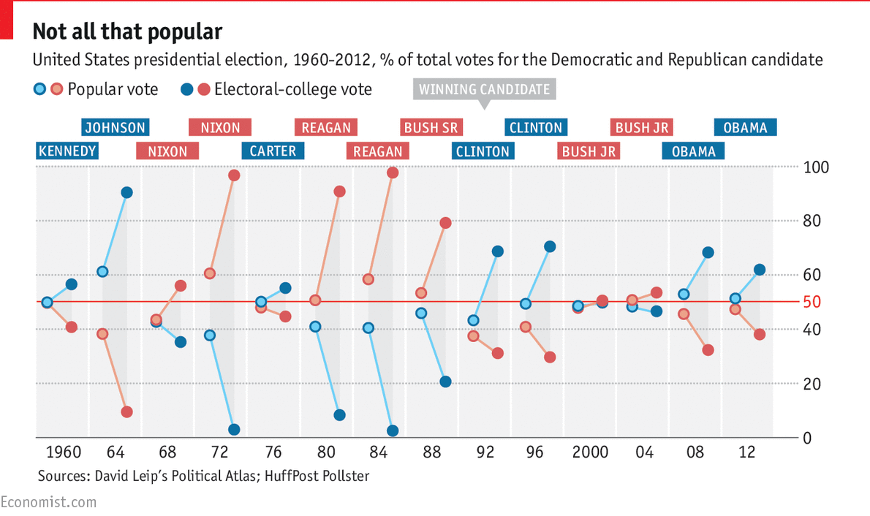
Presidential Elections 1960 - 2012

Slide 6
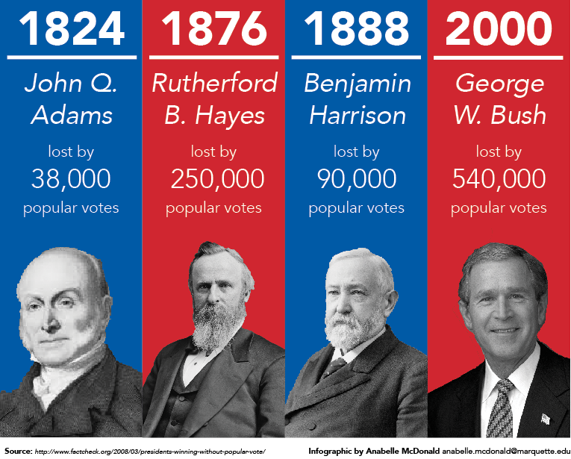
1824 / 1876 / 1888 / 2000 / 2016

Slide 7
1824
John Q. Adams v. Henry Clay v. Andrew Jackson
First election where a large majority of states chose electors by popular vote.
Jackson actually received most electoral votes (99) and most popular votes.
However, with four candidates, none received a majority.
Election thrown to House, where Speaker Clay supported Adams over Jackson.

Slide 8
1876
Rutherford B. Hayes v. Samuel Tilden
Tilden won popular vote and was ahead 184-165 in Electoral College.
Both parties claimed remaining 20 Electoral College votes from three states – Congress had to determine winner.
Commission of 10 Congressmen and 5 Justices was created.
Commission accepted Republican vote for Hayes in three states.
House disagreed, Senate concurred, Hayes declared President.

Slide 9
1888
Benjamin Harrison v. Grover Cleveland
Cleveland won almost 100,000 more popular votes.
Harrison won Electoral College 233 to 168.
Republicans carried Cleveland’s home base of New York.

Slide 10
And More Recently…
2000 Bush loses by 540,000 popular votes but wins Electoral College 271-266
2016 Trump loses by over 3 million popular votes but wins Electoral College 304-227
  Note, negative normalized “victory” margin was actually greater in the 1888 election (0.162% v. 0.130%).

Slide 11
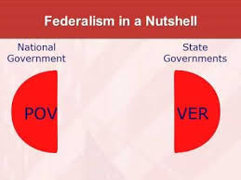
So Why Does the Electoral College Matter?

Slide 12
Alexander Hamilton in Federalist No. 68
“The mode of appointment of the Chief Magistrate of the United States is almost the only part of the system, of any consequence, which has escaped without severe censure, of which has received the slightest mark of approbation from its opponents.”
“…if the manner of it be not perfect, it is at least excellent.”

Slide 13
Avoids Pure Nationalization of Elections by Advancing Federalism
It protects federalism – the idea that all governmental power should not be concentrated in one branch or in one unit of government.
Horizontal / Vertical Separation of Powers + Art. I Sec. 8 / 10th Amendment = Federalism
Separation of state and national power is a “double security … to the rights of the people.” James Madison
The Constitution “extends to certain enumerated objects only, and leaves to the several States a residuary and inviolable sovereignty over all other objects.”

Slide 14
Forces Broad Support
Swing States Actually Swing Three Closest State Results over Last Four Election Cycles
2004 | WI | IA | NM
2008 | MO | NC | IN
2012 | FL | NC | OH
2016 | MI | NH | PA

Slide 15
Localizes the Election Process
In most states, there is an overarching elections board (or secretary of state), but the actual administration of elections is conducted at the local municipal levels.
States and local municipalities, not the federal government, are the key players in election law.
Decentralization makes manipulation difficult.

Slide 16
Broad, Geographically Balanced Coalitions
1/5 of Clinton votes in 2016 came from three states: CA, NY, IL
“Swing states” are representative of nation as a whole – IA, WI, NH, OH, FL, NV, VA, MI, MN, CO, PA
Swing states are still fluid – MN turning red and VA turning blue?
Seven Clinton states had GOP governors while five Trump states had Dem governors.
Obama states in 2012 swung back to GOP in 2016.
Trump winning “Blue Wall” states of WI, MN, PA has altered the electoral landscape. Will the spending in these states divert from spending elsewhere, like MN?

Slide 17
Mitigates Widespread Voter Fraud
50 states = 50 air tight compartments on an ocean liner.
A leak in one compartment does not result in the entire ship sinking.
See Florida in 2000. Difficult situation, but recount restricted to one state
See Wisconsin in 2016…

Slide 18
Clear Winner and Peaceful Transfer of Power
See Elections of 1800, 2000, 2016
Recounts under NPV would be more prevalent and more problematic.
Recount rules are different for every state.
Recounts throughout the nation would be incentivized.
Fights over provisional ballots could result in nationwide litigation.

Slide 19
Maegan Carberry, Salon, May 7, 2017
“Why doesn’t anyone know we’re incredibly close to replacing the Electoral College with the popular vote?”

Slide 20
What Would a National Popular Vote Look Like?
Would require another Washington D.C. Bureau or Department to conduct election administration.
Presidential appointees would end up running presidential elections.
No need for broad coalition. Simply focus on urban centers.
No way to address voter fraud if spread throughout the country and no real incentive to secure integrity of all fifty voting blocks.
If no clear winner, i.e. close national vote total and multiple claims of vote fraud or suppression, risk of “illegitimate” president increases.
Could result in a plethora of candidates, allowing a candidate to win the presidency with well below majority support.

Slide 21
Threats Have Never Been Greater
NPV movement is a political organization out of San Francisco.
Would create an interstate compact where states that pass NPV’s legislation would agree to disregard the vote count in their respective state and instead appoint electors who would support the winner of the national vote.
Compact does NOT require Constitutional Amendment.
So an end-run around constitutional amendment process.
Take effect if passed by states with a total of 270 or more Electoral College votes, i.e. enough to win the presidency.

Slide 22
Threats Have Never Been Greater
STATE | # EC Votes | Year Passed | STATE | # EC Votes | Year Passed
CA | 55 | 8/8/11 | NJ | 14 | 1/13/08
WA | 12 | 4/28/09 | NY | 29 | 11/7/16
HI* | 4 | 5/1/08 | CT | 7 | 5/24/18
CO | 9 | 3/15/19 | MA | 11 | 8/4/10
IL | 20 | 4/7/08 | VT | 3 | 4/22/11
MD | 10 | 4/10/07 | RI | 4 | 7/12/13
DC | 3 | 10/12/10 | NM | 5 | 4/3/19
DE | 3 | 3/28/19
14 Total States + Washington D.C. = 189 EC Votes 81 EC votes from 270 *overrode Gov. Lingle’s veto

Slide 23
Threats Have Never Been Greater
According to the NPV Movement:
“The National Popular Vote bill has now passed a total of 37 state legislative chambers in 23 states. It has also passed one legislative chamber in 8 states possessing 72 electoral votes (AR, AZ, ME, MI, NC, NV, OK, OR). It has been unanimously approved at the committee level in 2 states possessing 27 more electoral votes (GA, MO). The National Popular Vote bill has been introduced in various years in all 50 states.”

Slide 24
Legal?
Could survive a court challenge – Constitution gives legislatures power over the appointment of state electors.
HOWEVER, Article I, Section 10, Clause 3 of Constitution prohibits any state from entering into any Agreement or Compact with another state without the consent of Congress.

Slide 25
Questions?
Feel free to email or direct message with questions or comments following the presentation:
curtis.Ozaukee@gmail.com
@JacobJCurtis

